Slide 1
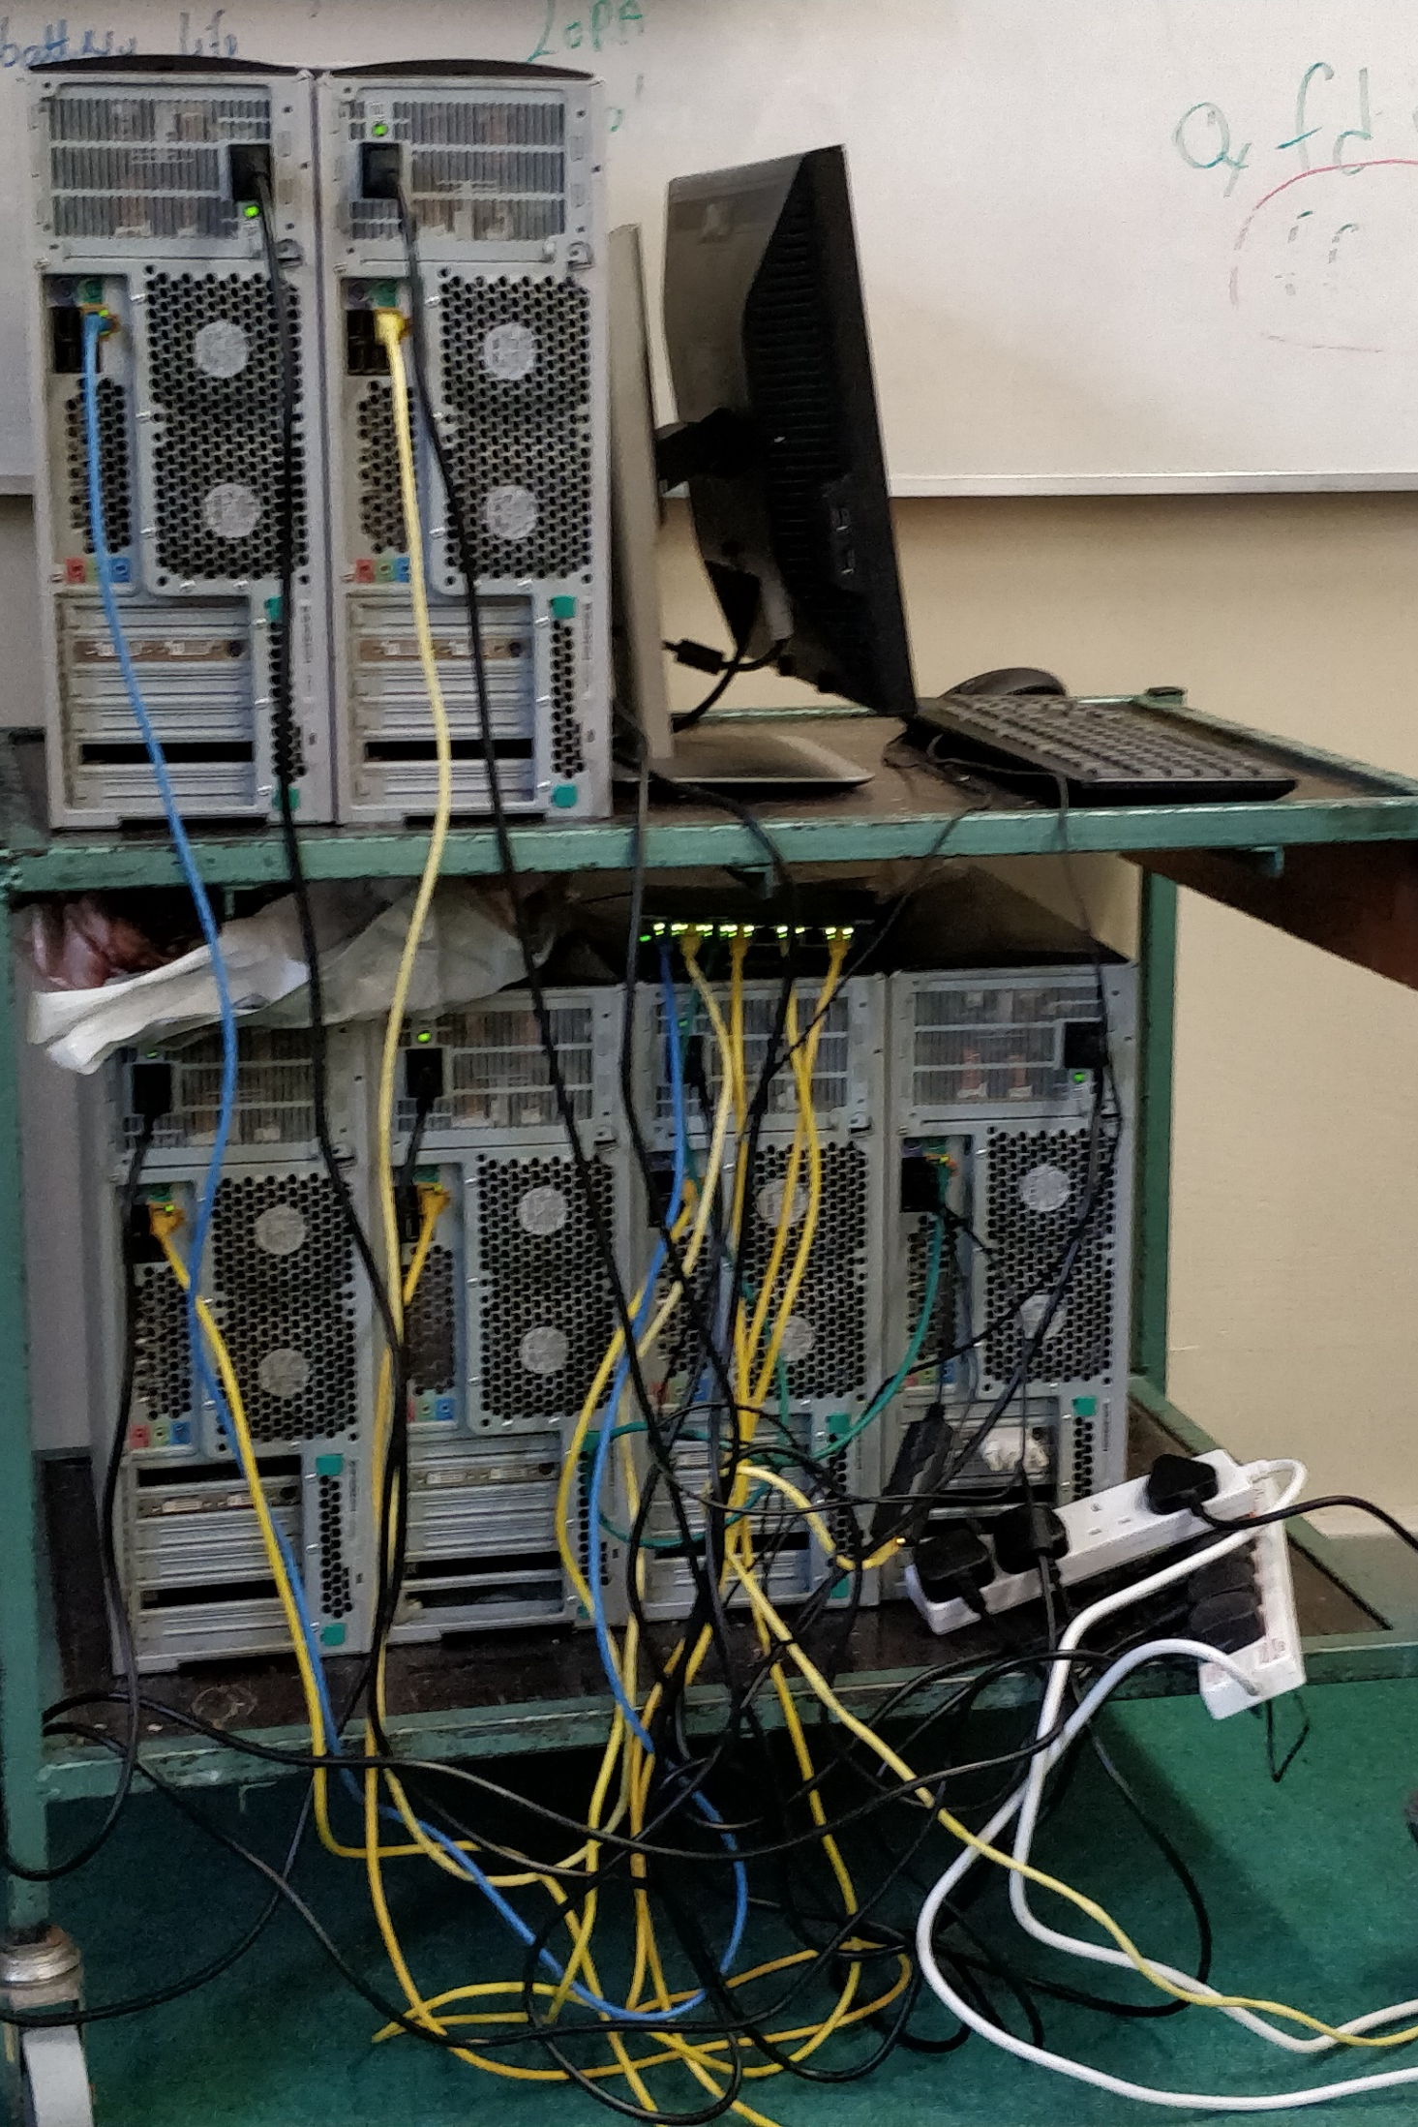

Construction of a Beowulf High Performance Computing Cluster for simulation of Quantum Confinement
Timothy Merriman
Supervisor: Dr. Kevin Berwick
Notes:
2 parts
Cluster
Simulation

Slide 2
Introduction
What is a Beowulf Cluster?
What is Quantum Confinement?
Notes:
Beowulf:
Nodes connected on LAN
Libraries + programs share processing power
Consumer grade electronics
Result high performance parallel computing cluster
Quantum:
Effect that occurs relating to electronic and optical properties of a material
Less than 10nm

Slide 3
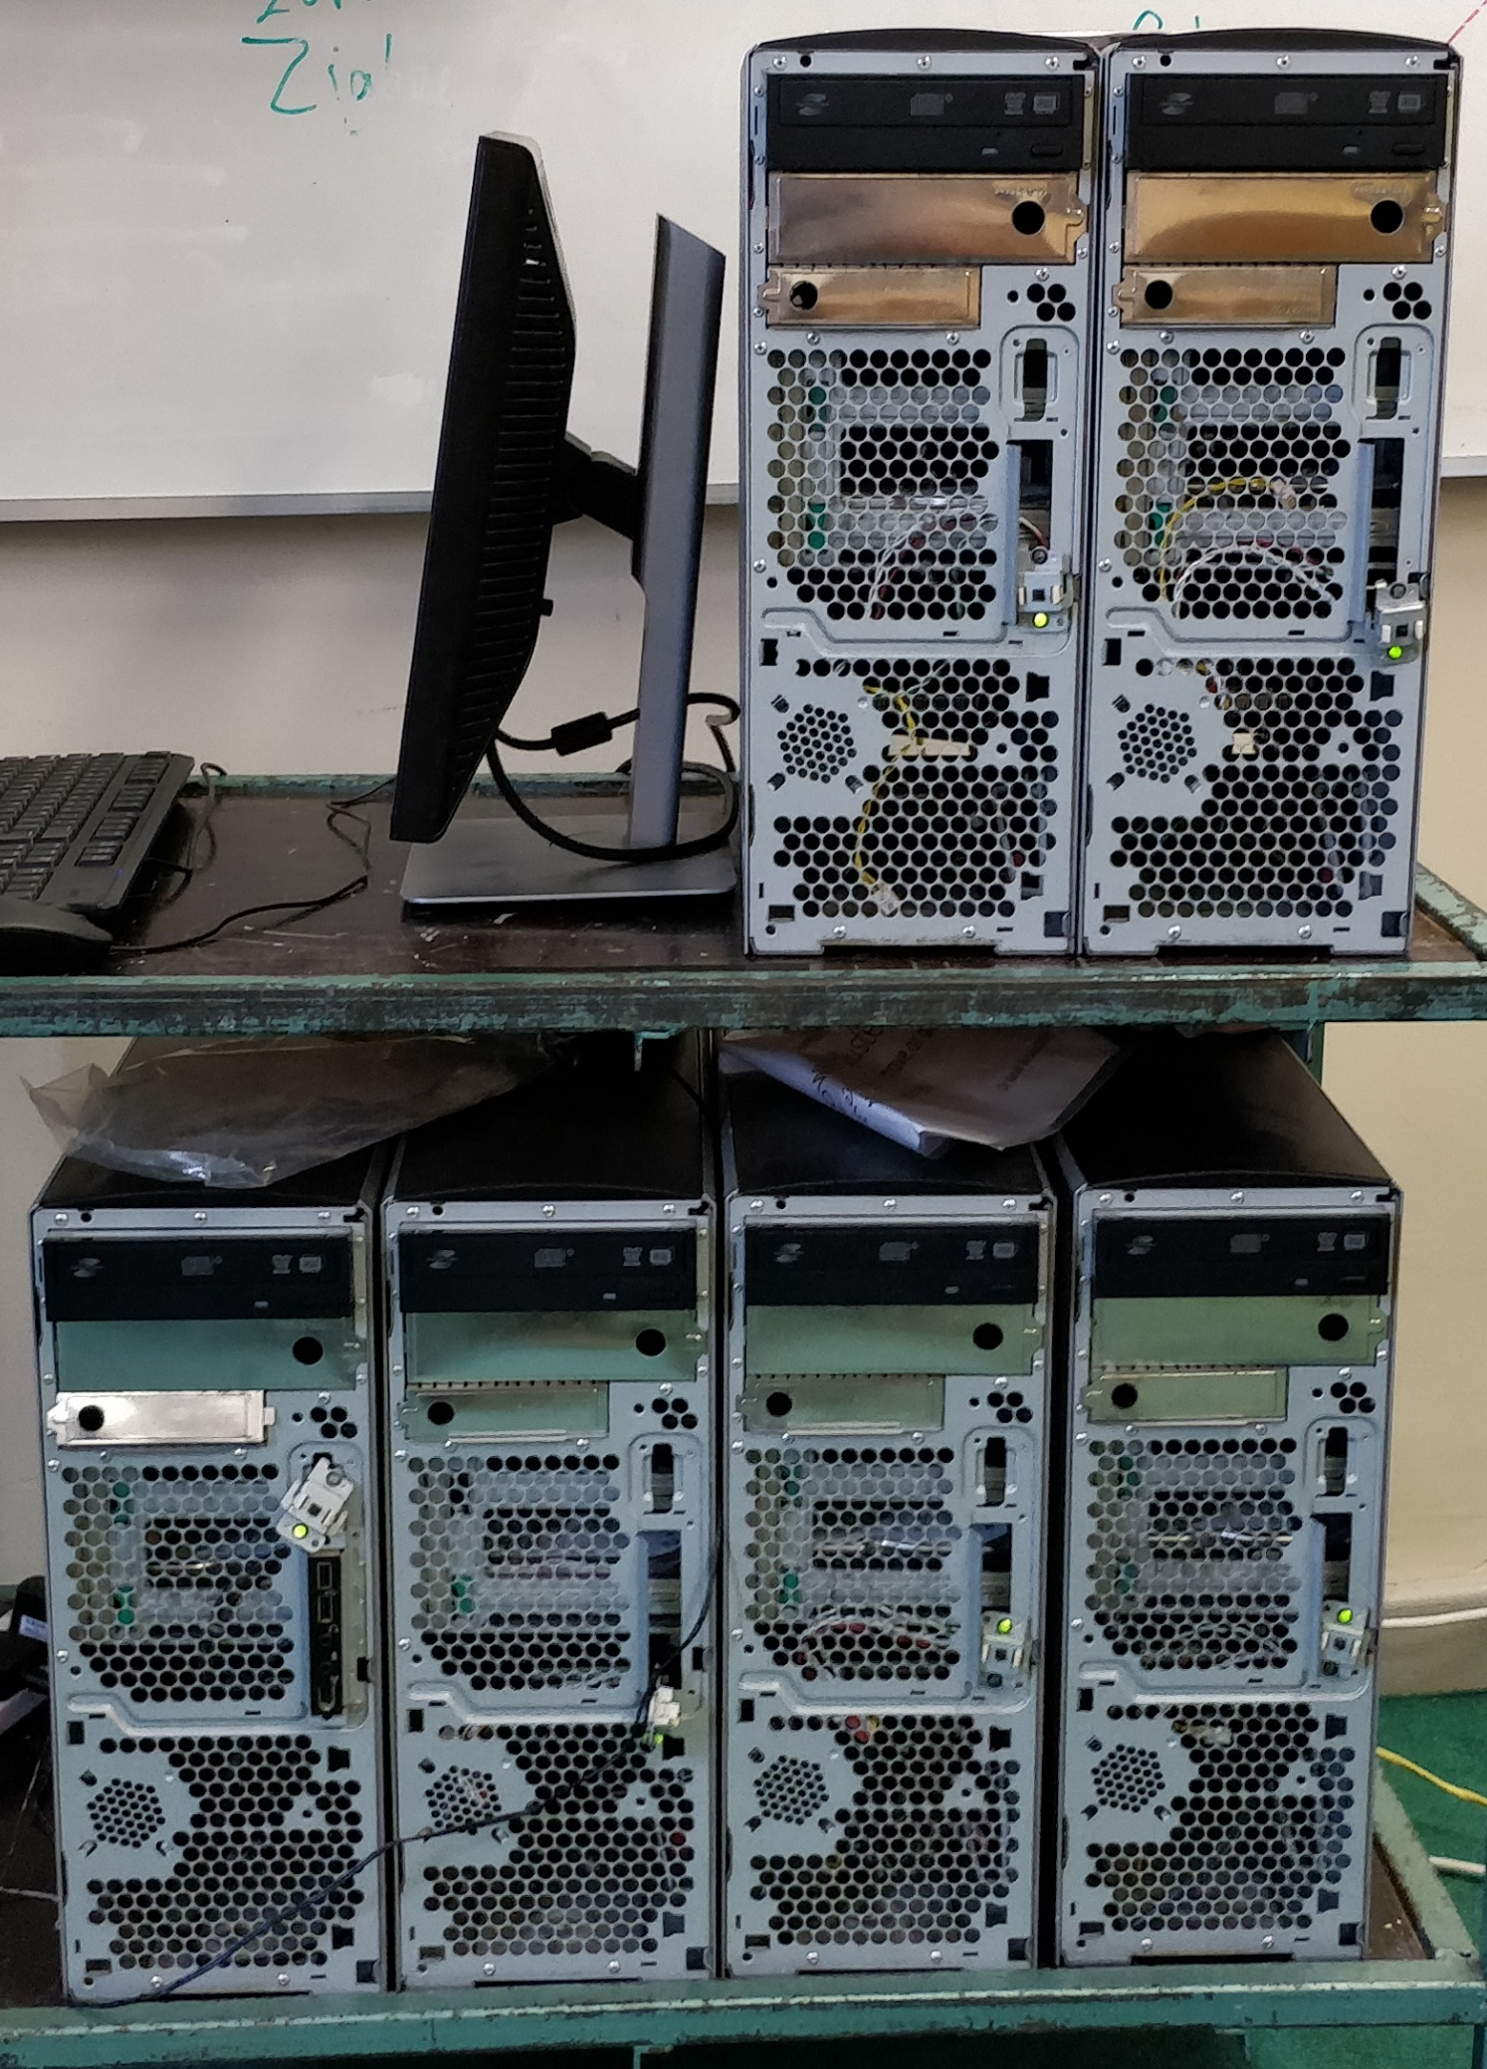
Beowulf Cluster
Is this cluster a super computer?
Cluster setup:
SSH
Shared File system (ZFS)
MPI (Message Passing Interface)
https://www.top500.org/
Notes:
Used LINPACK so top500.org
Update every 6 months to keep up
Benchmark Results:
Talk about all results in graph
In the year 2001 (Twin Towers collapsed) 360 on top500 list
Cluster setup:
Protocol built into Julia
Remote access through firewall using vapp

Slide 4
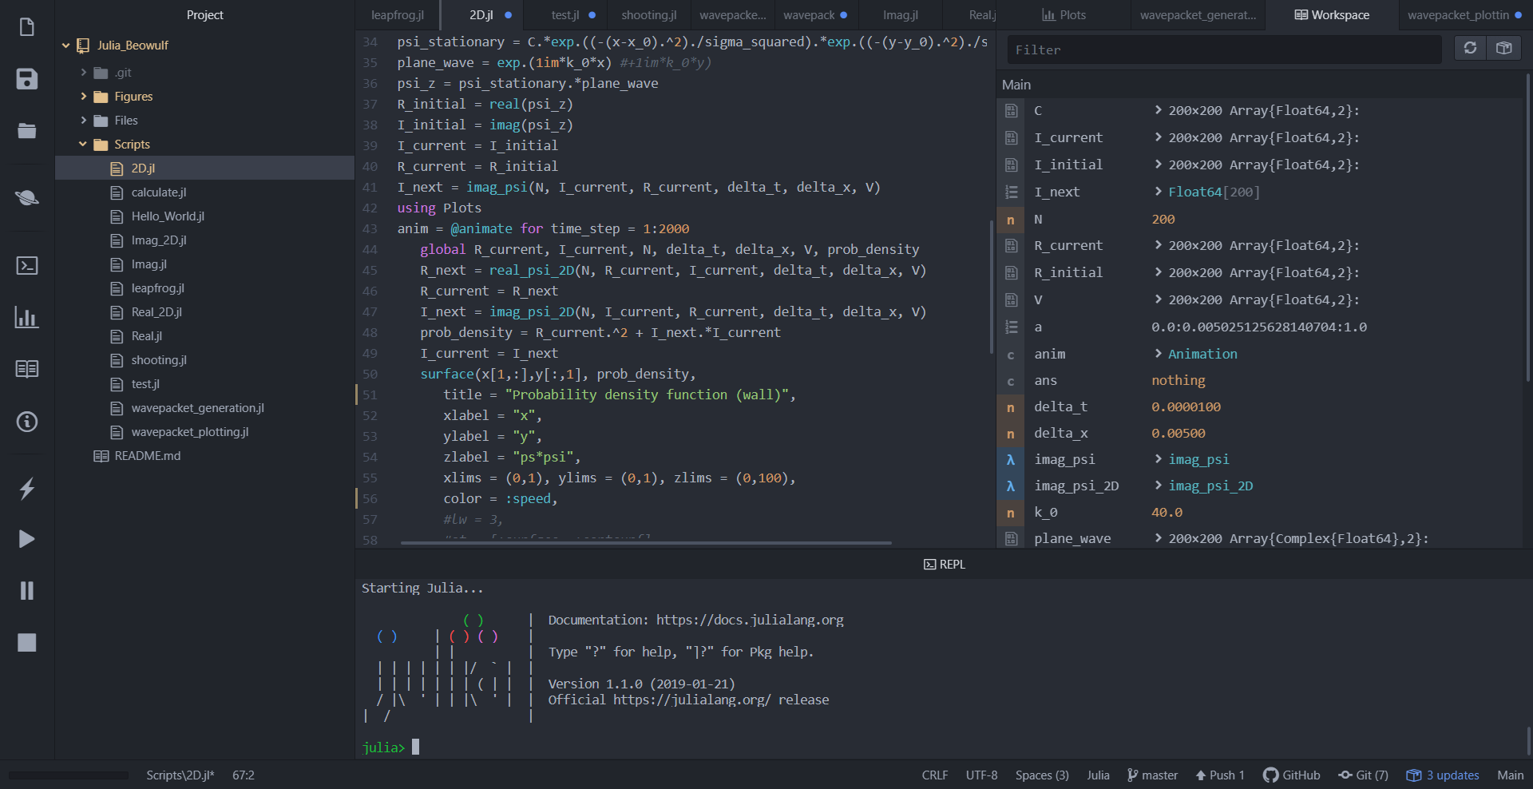
Julia - Language
Julia is:
Fast
Dynamic
Optionally typed
General
Easy to use
Open Source
https://julialang.org/
Notes:
List is according to website
3 things I noticed
Fast
Easy to use (Describe IDE) – file structure, code tabs, workspace, plots, console output, GitHub integration (transfer code from laptop to cluster)
Open source, Z-axis label only just implemented

Slide 5
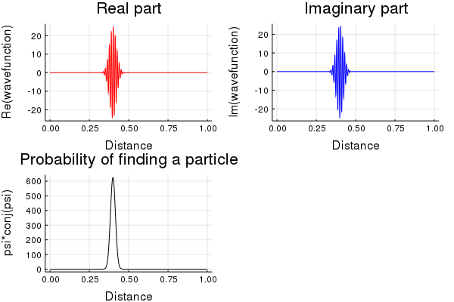
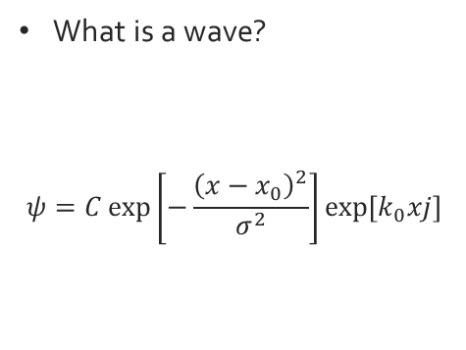
Wave Packet Construction
What is a wave?
$$ψ=C\exp\left[−\frac{{\left(x−x_{0}\right)}^{2}}{σ^{2}}\right]\exp\left[k_{0}xj\right]$$
Julia code: ψ = C.*exp.((-(x-x_0).^2)./(σ^2)).*exp.(k_0*x*1im)
Notes:
A wave is the probability of finding a particle in that region of space
Julia code uses exp.(), also support symbols
For this equation psi is the label for the wave equation, C is a factor, k_0 is the wave vector, sigma is the root means squared.
C = 25, x_0 = 0.4, x = 0:1, k_0 = 500, sigma = 0.03 (sigma_squared = 0.0001)

Slide 6
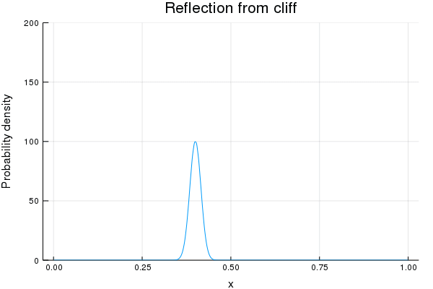
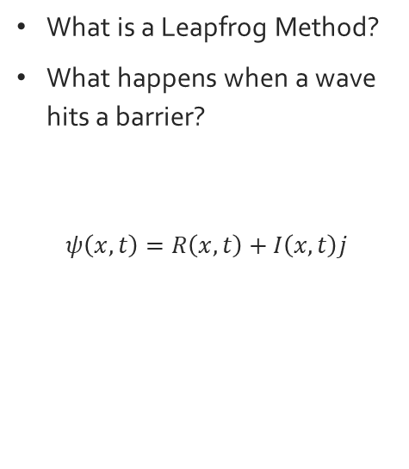
One-Dimensional Leapfrog Method
What is a Leapfrog Method?
What happens when a wave hits a barrier?
$$ψ\left(x,t\right)=R\left(x,t\right)+I\left(x,t\right)j$$
Notes:
The Leapfrog method involves calculating the real and imaginary parts of the equation separately in a staggered fashion (pg. 335 of Giordano)
The real part is calculated using t and delta_t whereas the imaginary part uses +delta_t/2 and –delta_t/2. hence the staggered fashion.
X is distance, t is timestep

Slide 7
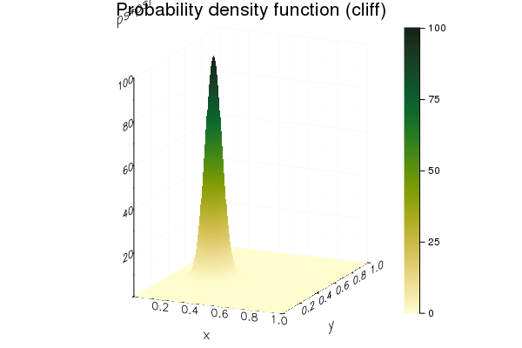

Two-Dimensional Leapfrog Method
Notes:
Similar method but 2D

Slide 8
Conclusion
What’s left to do?
  Make the cluster smaller
  Julia to Parallel Julia conversion of code
  Make cluster more powerful?
Blog: https://beowulfcluster.home.blog

